Slide 1
Stereoscopic Depth Mapping
Eric Henderson, Nick Kamper, Laura Moss, James Savage
CSSE463 – Image Recognition
Notes:
Nick

Slide 2
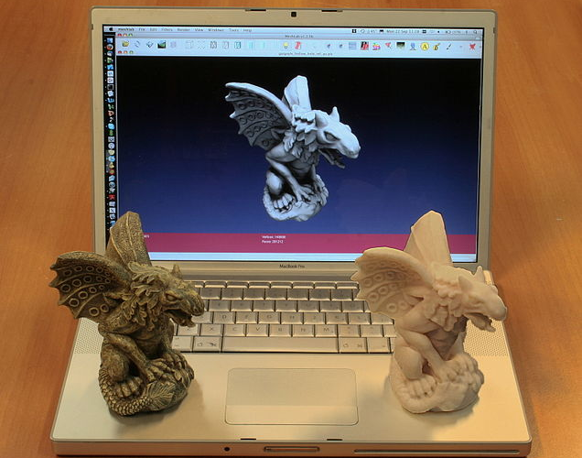
Where’s Depth Mapping Used?
Notes:
Nick
3D modelling is a popular application of depth mapping, even more popular with the advent of DIY 3D printers, such as the Reprap

Slide 3
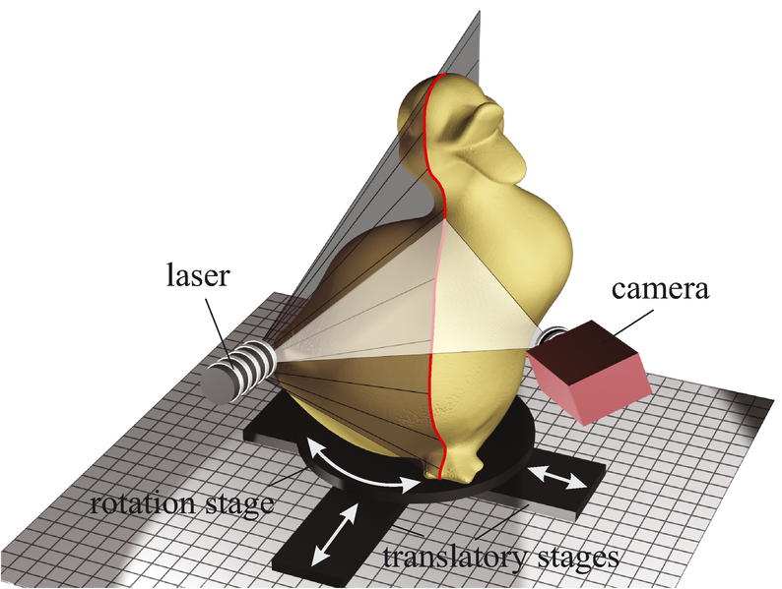
Where’s Depth Mapping Used?
Notes:
Nick
“Scanning” a physical 3D object can use an apparatus like such, which spins the object around while shining a laser on it

Slide 4
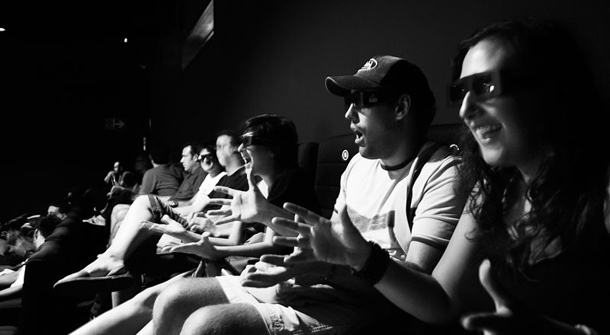
Where’s Depth Mapping Used?
Notes:
Nick
3D movies are becoming more and more popular

Slide 5
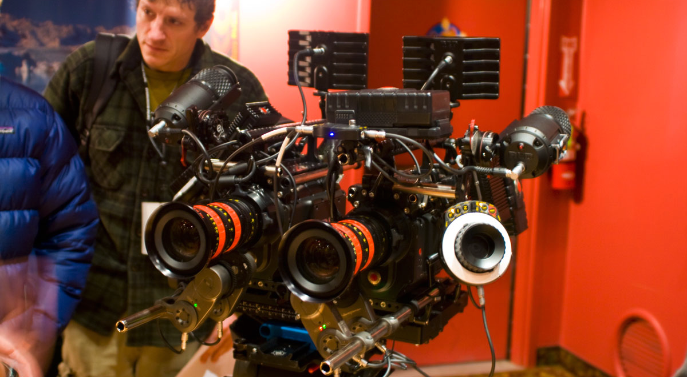
Where’s Depth Mapping Used?
Notes:
Nick
The RED 3D camera, used to film several blockbuster 3D films

Slide 6
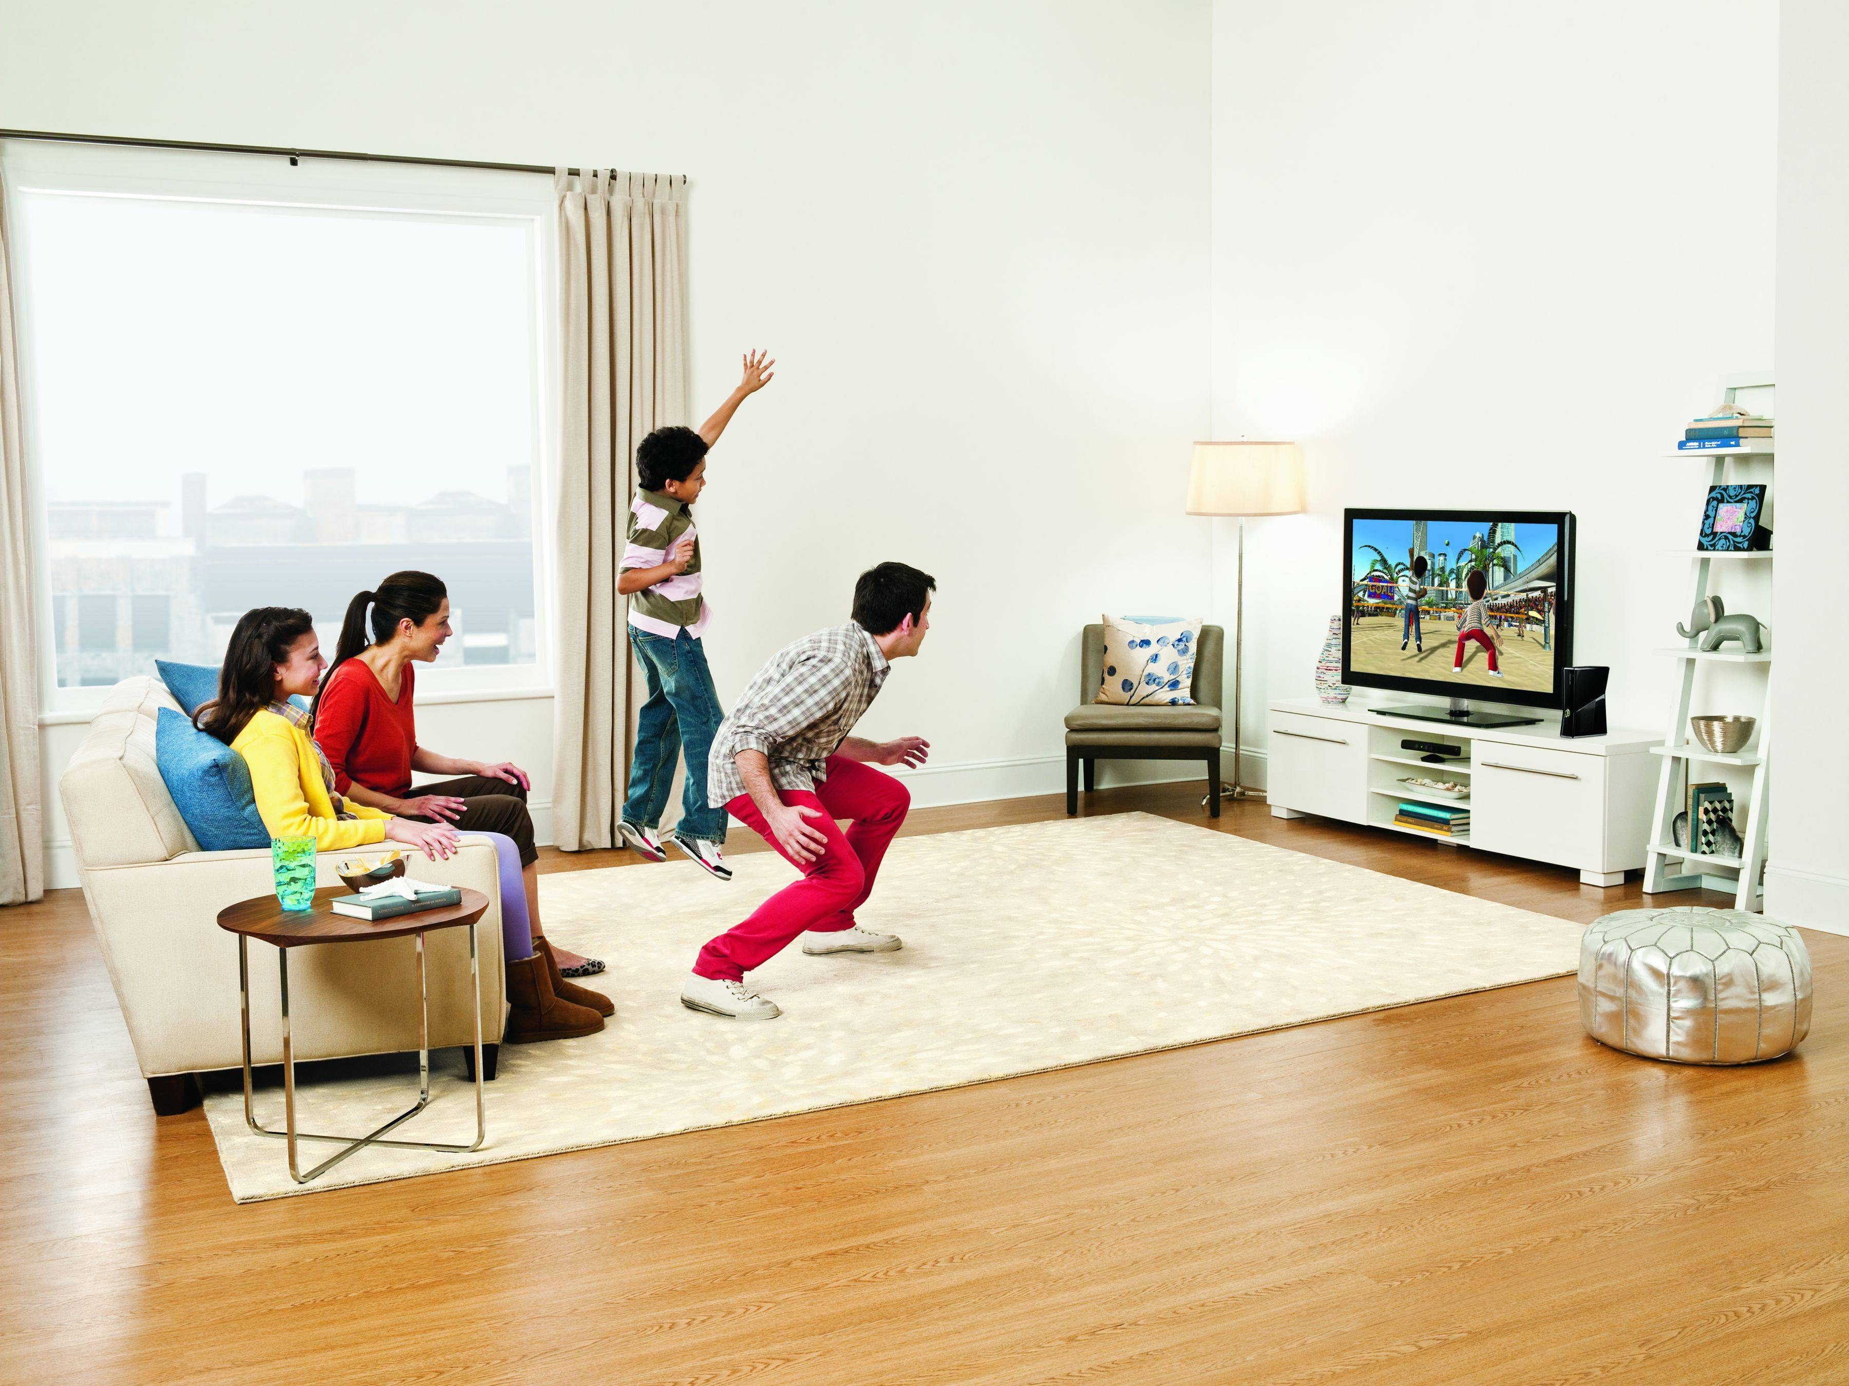
Where’s Depth Mapping Used?
Notes:
Nick
Xbox Kinect brings depth mapping to consumer applications to detect gestures and body movements

Slide 7
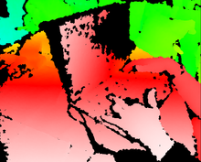
What do these have in common?
Notes:
Nick
They all generate depth information!

Slide 8
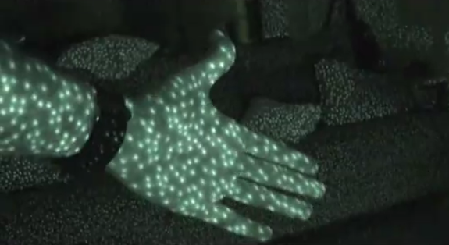
Ways of Implementing Depth Mapping
Notes:
Nick
Light-based depth mapping, which shines a laser on a scene and measures how the scene responds to it (such as the size of the laser dots)

Slide 9
Ways of Implementing Depth Mapping
Notes:
Nick
Stereoscopic depth mapping, which uses two fixed cameras. Uses distances of corresponding points and information about the cameras (such as the distance and field of view angle) to triangulate the distance of the object from the camera

Slide 10
Ways of Implementing Depth Mapping
Notes:
Nick
The RED 3D camera, used to film several blockbuster 3D films

Slide 11
Wait, I thought this was Image Recognition!
Stereoscopic Depth Mapping is a computer vision problem
However, we can apply image recognition techniques to solve a few problems within stereoscopic depth mapping.
Notes:
Eric

Slide 12
Basic Algorithm for Stereoscopic Depth Mapping
Find corresponding points in the stereo images
Using information about the cameras and the distance between the corresponding points, perform some trigonometry to get the distance of that point from the camera
Notes:
Eric

Slide 13
Basic Algorithm for Stereoscopic Depth Mapping
Notes:
Eric
Stereoscopic depth mapping, which uses two fixed cameras. Uses distances of corresponding points and information about the cameras (such as the distance and field of view angle) to triangulate the distance of the object from the camera

Slide 14
Other Ways of Matching Points
If we knew the camera’s intrinsic parameters (such as the focal length, principal point, scale, and skew), we could find the epipolar line for a given point
The corresponding point in the other image would lie on the epipolar line in the other image
However, calibrating a camera to get the parameters is messy, so we use a different image recognition-based approach
Notes:
James

Slide 15
A Failed Approach to Finding Interesting Points
Directed Variance
Found point clusters rather than points
Often identified single pixels of noise in the image, because of their technically high variance
Notes:
James

Slide 16
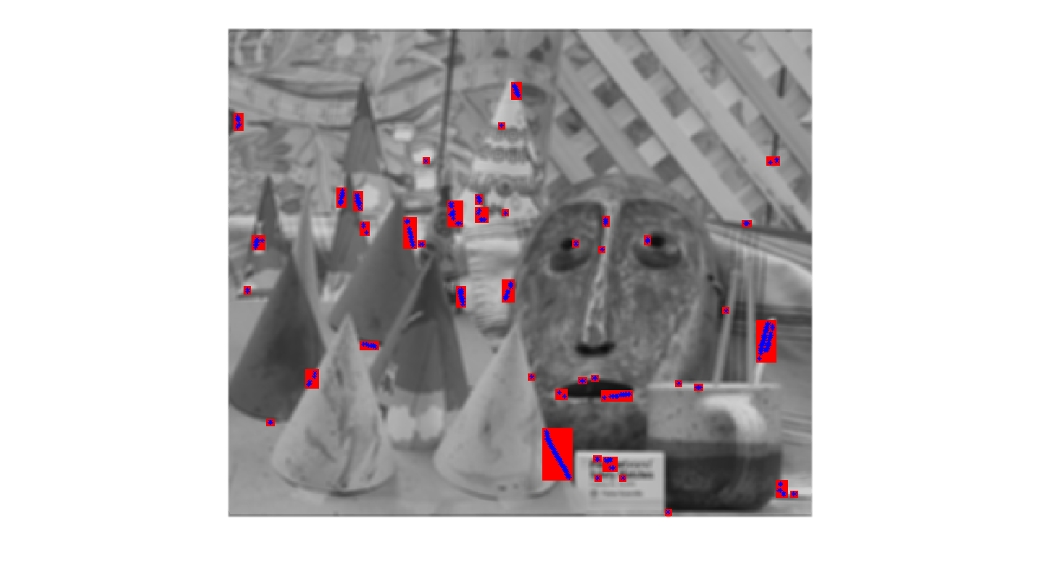
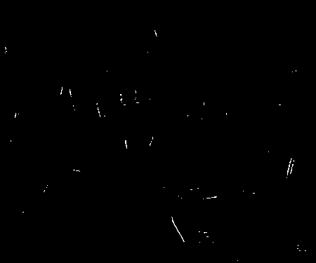
Demo of Failed Approach
Notes:
James

Slide 17
Our Working Approach to Finding Interesting Points
To find interesting points to correspond, we use the Harris/Stephans corner detection algorithm (available in MATLAB)
Why corners? Because they’re “different” enough that the features should be easy to compare!
The main idea of the Harris/Stephan Corner Detection Algorithm is to find areas with well-defined spikes in output from the X and Y partial derivatives.
Notes:
Nick

Slide 18
Robert Collins, Penn State University
Notes:
Nick

Slide 19
Approaches to Matching Points
We then compare features of the interesting points in one image to those in the other image to find a match
Currently, we’re just using template matching using a window surrounding the interesting point and comparing RGB color distance to corners found in the corresponding image
Works reasonably well
Can’t guarantee that the same corners will be found in both images
Tried template-matching a window from a starting point in a spiral
Bad performance
Eventually want to incorporate edges and other features into our feature comparison
Notes:
Laura

Slide 20
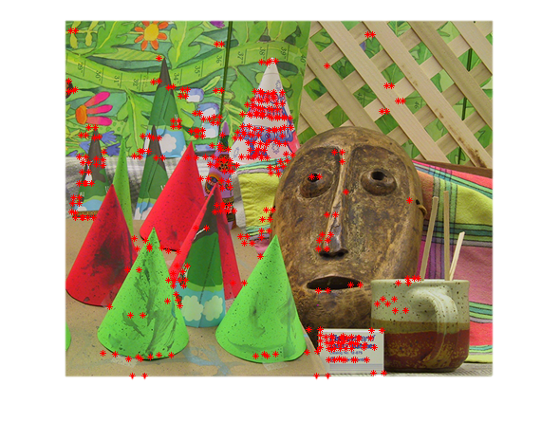
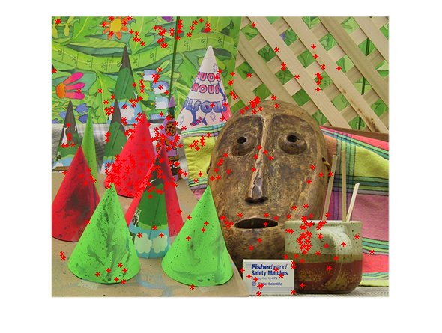
Demo of Failed Point Matching Approach
Directed Variance interesting points (left), corresponding points using template matching (right)
Notes:
Laura
Picked up spots on coffee mug, edges of letters on box and party hat
It is clear that template matching doesn’t work well because the matches are completely scattered

Slide 21
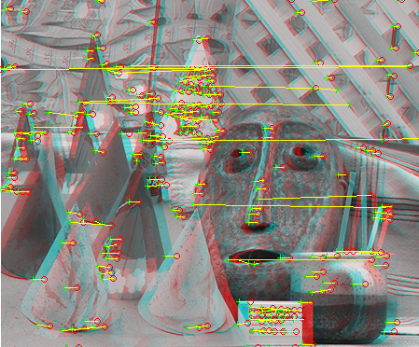
Demo of Matched Points using Corresponding Corners
Notes:
Laura
Plenty of good matches, but you can see many outlier points (long distances)
Result of using a greedy algorithm to choose a corresponding point, or the actual corresponding corner was not detected

Slide 22
Depth Mapping
Only can determine relative distances
If we had more information (field of view angle), we would be able to find actual distance from the cameras
Notes:
James

Slide 23
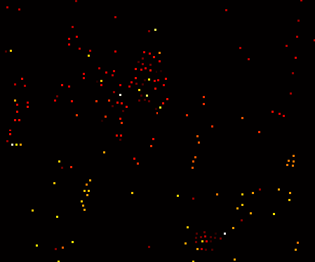
Demo of Depth Mapping using Corresponding Corners
Notes:
James

Slide 24
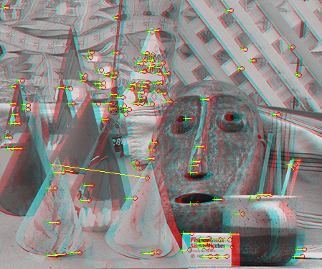
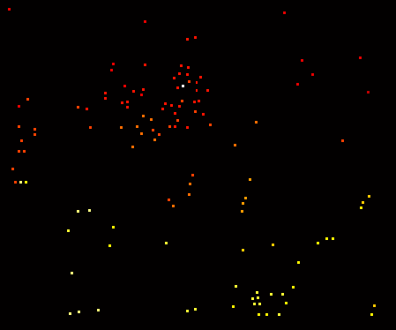
Demo of Depth mapping using MATLAB’s point matcher
Notes:
James

Slide 25
Lessons Learned
Corresponding points is HARD – and we’re only trying to solve a specific subset!
Corresponding a lot of points is even harder – especially in areas without a lot of texture or variation
MATLAB can be treacherous to optimize
Notes:
Laura

Slide 26
Lessons Learned
Notes:
Laura
Use to talk about lack of texture.

Slide 27
Lessons Learned
Corresponding points is HARD – and we’re only trying to solve a specific subset!
Corresponding a lot of points is even harder – especially in areas without a lot of texture or variation
MATLAB can be treacherous to optimize
Notes:
Laura

Slide 28
Questions? Comments? Concerns? Interesting Anecdotes?

